Slide 1


QR Code
Risankizumab is Superior to Ustekinumab for Induction and Maintenance of Crohn’s Disease: The SEQUENCE Trail
Original Article
QR Code
Article Covered: Risankizumab versus Ustekinumab for Moderate-to-Severe Crohn’s Disease. N Engl J Med. 2024;391(3):213-223. doi:10.1056/NEJMoa2314585
EBGI Summary

Slide 2
Study Question
Is risankizumab, a p19 subunit-specific interleukin (IL)-23 monoclonal antibody, as efficacious and safe as ustekinumab, a dual IL-12/23 inhibitor, in the treatment of patients with moderate-to-severe Crohn’s disease who previously had unacceptable side effects or an inadequate response to at least one anti-tumor necrosis factor (TNF) therapy?

Slide 3
Why is This Important?
Head-to-head trial comparing treatment options for IBD provide the most robust data, they are most clinically pertinent to patients, physicians and the insurers and hence are the most practice-changing but there are only few to date
The SEAVUE is the first RCT to directly compare 2 biologic agents for the treatment of Crohn’s disease, that compared Ustekinumab with Adalimumab in patients with moderate to severe Crohn’s disease in biologic-naïve population and helped position first line biologic agents in moderate to severe Crohn’s disease
SEQUENCE helps position second line agents for Crohn’s disease by comparing Ustekinumab to Risankizumab in biologic-exposed population
doi.org/10.1056/nejmoa0904492
doi.org/10.1056/nejmoa1905725
doi.org/10.1016/s0140-6736(17)30068-5
doi.org/10.1016/s0140-6736(22)00688-2

Slide 4
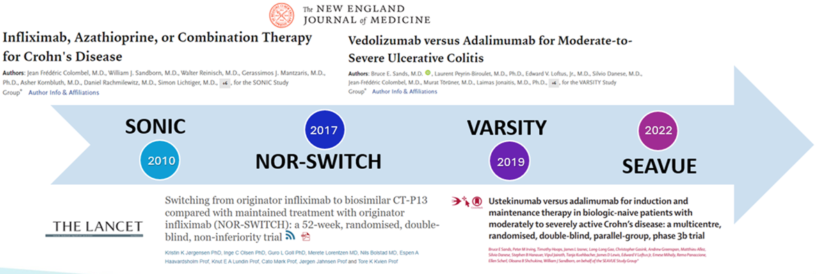
Why is This Important?
Head-to-Head Therapeutic Trials in IBD
doi.org/10.1056/nejmoa0904492
doi.org/10.1056/nejmoa1905725
doi.org/10.1016/s0140-6736(17)30068-5
doi.org/10.1016/s0140-6736(22)00688-2

Slide 5

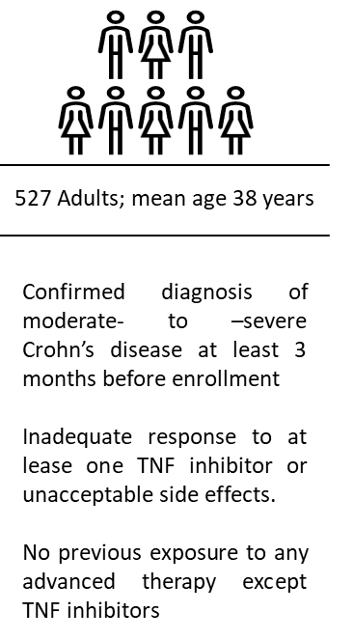


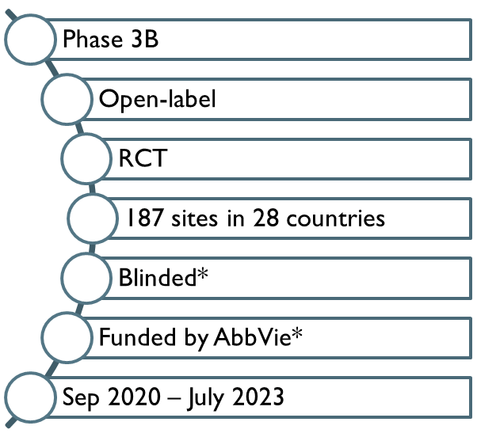
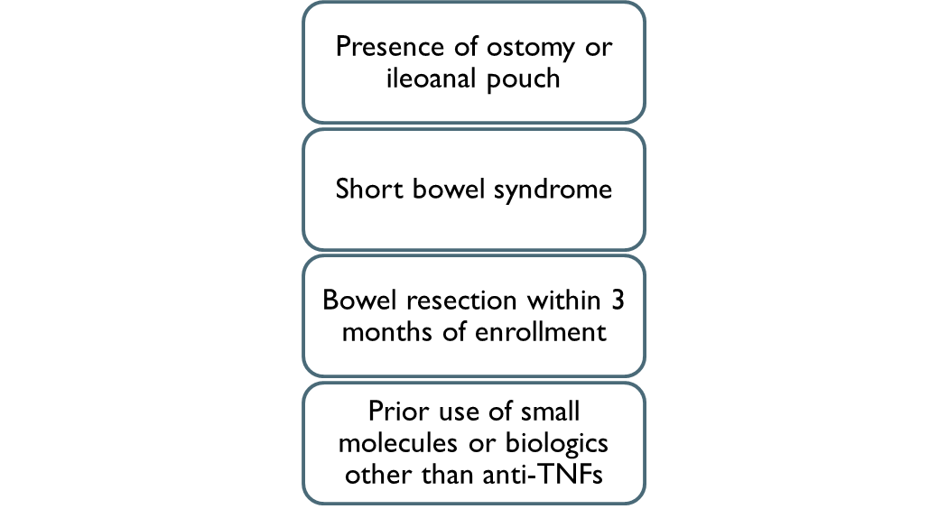
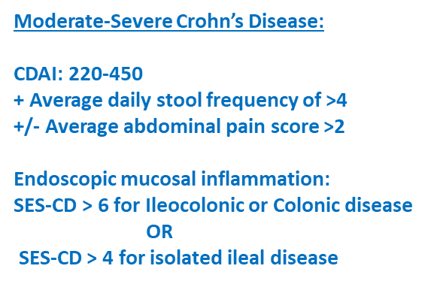

Slide 6
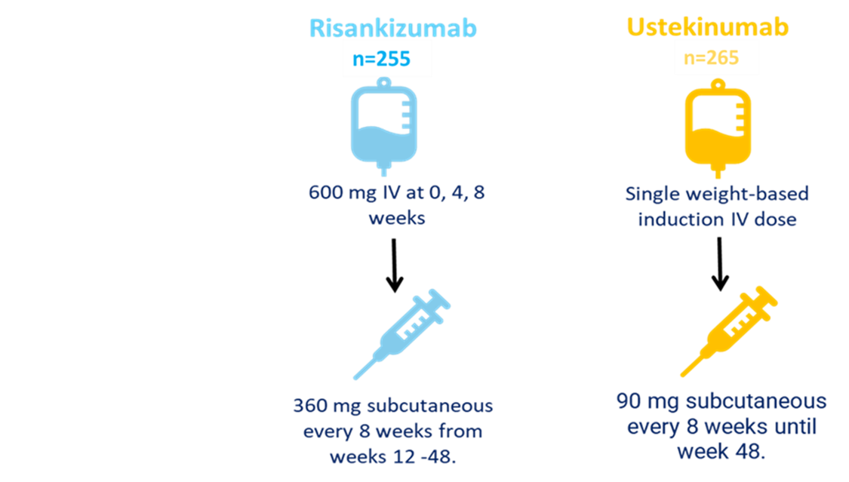
Interventions & Analyses
Randomization was stratified according to the number of previously received anti-TNF therapies that had failed (1 or >1) and glucocorticoid use at baseline (yes or no)
Dose changes and crossover from one group to the other were not permitted
All analyses were performed in the intention-to-treat population (patients who underwent randomization and received at least one dose)
A mandatory steroid taper was instituted starting at week 2. Patient on > 10 mg/ day dose were tapered at a rate of 5 mg/week and < 10 mg/d dose were tapered at 2.5 mg/week rate

Slide 7
Outcomes & Definitions
Glucocorticoid-free clinical and endoscopic remission at week 48 (defined as not receiving glucocorticoids at the week 48 visit)
Endoscopic response at week 48 (reduction in the SES-CD of >50% from baseline [or for patients with isolated ileal disease and a baseline SES-CD of 4, a ≥2-point reduction from baseline])
Clinical remission at week 48 (CDAI Score < 150)
Secondary Endpoints
Clinical remission at week 24 (CDAI Score < 150)
Non-inferiority analysis in first 50% enrolled patients
Margin 10% points
Endoscopic remission at week 48 (SES-CD of <4; and at lest 2-point reduction from baseline and no sub-score > 1 in any individual variable)
Superiority analysis in 100% patients
Primary Endpoints
Safety:
Assessed in all patients who underwent randomization and received at least one dose of risankizumab or ustekinumab

Slide 8
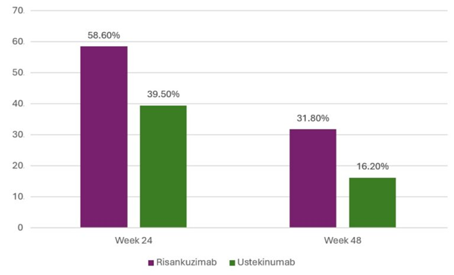
Results
Median age was 38 years, 49% female; 74% White; ileocolonic disease 43%, ileal disease 17%, colonic disease 40%; median duration of disease 7.3 years and mean CDAI score was 307
Approximately 25% of the patients were taking glucocorticoids at baseline; mean (±SD) daily prednisone-equivalent dose at baseline was 21.4±12.9 mg in the risankizumab group and 19.5±10.7 mg in the ustekinumab group
90.2% of patients in the risankuzimab group (230/255) and 72.8% of patients in the ustekinumab group (193/265) completed all the assigned treatment
Risankuzimab was noninferior to ustekinumab with regards to clinical remission at week 24; adjusted difference, 18.4 percentage points (95% CI, 6.6 – 30.3)
Risankuzimab was superior to ustekinumab with regards to Endoscopic remission at week 48; Adjusted difference, 15.6 percentage points (95% CI, 8.4 – 22.9; P <0.001)
Clinical remission
Endoscopic remission
Notes:
The demographics and baseline characteristics of the patients were well balanced between the treatment groups.
Median age was 38 years, 49% female; 74% White; ileocolonic disease 43%, ileal disease only 17%, colonic disease only 40%; median duration of disease was 7.3 years; and, mean CDAI score was 307.
In approximately 25% of the patients, more than one anti-TNF therapy had previously failed.
Approximately 25% of the patients were taking glucocorticoids at baseline; the mean (±SD) daily prednisone-equivalent dose at baseline was 21.4±12.9 mg in the risankizumab group and 19.5±10.7 mg in the ustekinumab group.

Slide 9
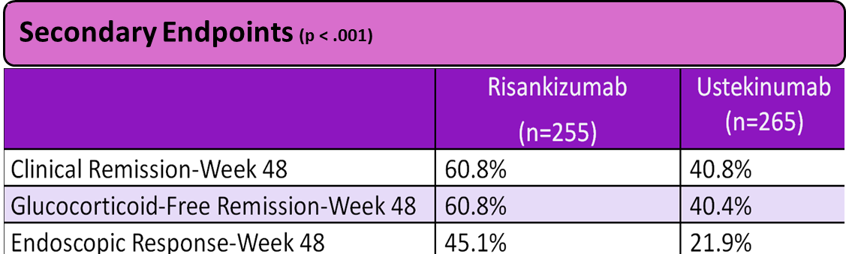
Results
Similar Adverse events in both groups
Similar Infections in both groups
Significantly less hospitalizations related to Crohn’s disease, or any other cause in the risankizumab group (4% vs 13%, -8.45% [95% CI, 3.31-13.60])
Serious events lower in Risankizumab group (10.3% vs 17.4%)
One case of skin squamous-cell cancer (risankizumab group) and one case of anal squamous-cell cancer (ustekinumab group)

Slide 10
Study Limitations
Open-label design, patients were not blinded to the treatment arm which could influence reporting of symptoms and safety events. To minimize bias, they ensured a blinded central reader of endoscopy findings
Risankizumab maintenance dosing was the higher 360 mg dose instead of the 180 mg maintenance dose, while dose escalation of ustekinumab to every 6 weeks or even every 4 weeks was not allowed
Finally, the drop-out rate was 28% in the ustekinumab arm versus 10% in the risankizumab arm, and this difference was primarily due to lack of efficacy in the ustekinumab arm, which may impact interpretation of results
Whether the superior efficacy of risankizumab is due to binding on the p19 subunit or if there are specific properties of the drug itself that allow for better tissue penetration or another feature that result in greater endoscopic efficacy is unclear
Finally, the superiority of risankizumab to ustekinumab in these moderate-severe Crohn’s disease patients whose anti-TNF agents have failed to treat their condition is not generalizable to ulcerative colitis on the basis of this trial
References

Slide 11
How Should We Apply This to Our Practice?
SEQUENCE clarifies the positioning of risankizumab and shows that it should be preferred as a second line agent after failure with an anti- TNF agent; due to greater efficacy for the stringent endpoint of endoscopic remission.
Ustekinumab will continue to have a large role in IBD. Since the financial burdens of biologic therapy are an important consideration and ustekinumab is an efficacious anti-IL 23 agent, it would be short sighted to overlook ustekinumab in the treatment of Crohn’s disease.
References

