Slide 1


QR Code
When to Discontinue CRC Screening in Older Adults: Chronological Age or Life Expectancy?
Original Article
QR Code
Article Covered: This summary reviews Liu PH, Singal AG, Murphy CC. Colorectal cancer screening receipt does not differ by 10-year mortality risk among older adults. Am J Gastroenterol 2024;119: 353-363.
EBGI Summary

Slide 2
Study Question
Among older adults (65-84 years) in the US, how often is colorectal cancer (CRC) screening performed in relation to 10-year mortality risk?

Slide 3
Why Is This Important?
By 2030, older Americans are estimated to make up 21% of the entire population, and by 2060, nearly 1 in 4 Americans will be 65 years or older.
USPSTF recommendations suggest clinicians to selectively offer CRC screening in adults 76 to 85 years old.
Recent studies suggest that we may be over-screening patients for CRC, and conversely, we may be under screening some patients older than 75 with longer life expectancy.

Slide 4


Study Design
Design: Retrospective, cross-sectional study using data from the National Health Interview Survey (NHIS)
Setting: Community-dwelling adults in the US
Patients: 25,888 adult respondents of the NHIS aged 65 to 84 years who were not up to date on CRC screening
Liu et al., American Journal of Gastroenterology 2023; Okafor, Evidence Based GI March 2024: 1-6.

Slide 5


Intervention
Completion of CRC screening
Colonoscopy
Flexible sigmoidoscopy
Stool-based tests
Liu et al., American Journal of Gastroenterology 2023; Okafor, Evidence Based GI March 2024: 1-6.

Slide 6
Outcomes & Definitions
Primary outcome: prevalence of CRC screening in the preceding 12 months, regardless of indication, stratified by 10-year mortality risk (Past-Year Screening)
Secondary outcomes:
  Proportion of CRC screening performed among adults with a life expectancy < 10 years (i.e. 10-year mortality risk ≥ 50%)
  Association between quintile of mortality index and receipt of past year screening
Schonberg mortality index used to estimate 10y mortality
10y mortality risk ≥ 50% = life expectancy﹤ 10y
Liu et al., American Journal of Gastroenterology 2023; Okafor, Evidence Based GI March 2024: 1-6.

Slide 7
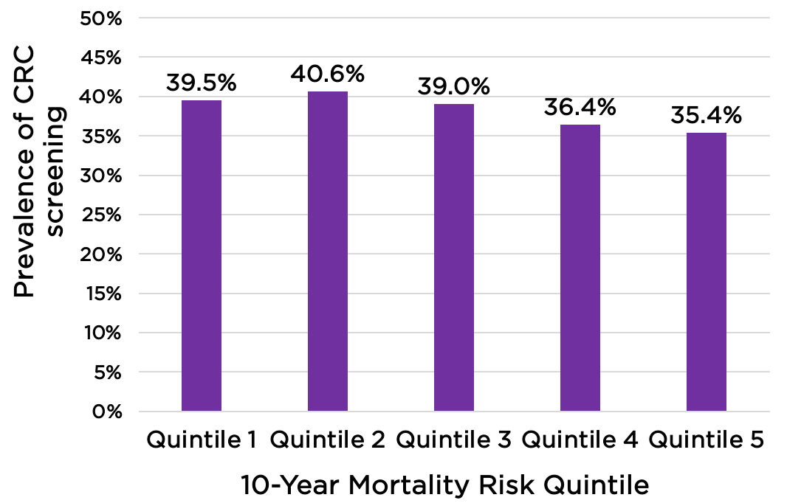
Results
38.5% overall prevalence of past-year CRC screening in the study population
Stratified by mortality risk quintiles, prevalence of past-year screening ranged from 39.5%-40.6%
  There was no association between receipt of past year CRC screening and mortality risk quintile
Liu et al., American Journal of Gastroenterology 2023; Okafor, Evidence Based GI March 2024: 1-6.

Slide 8
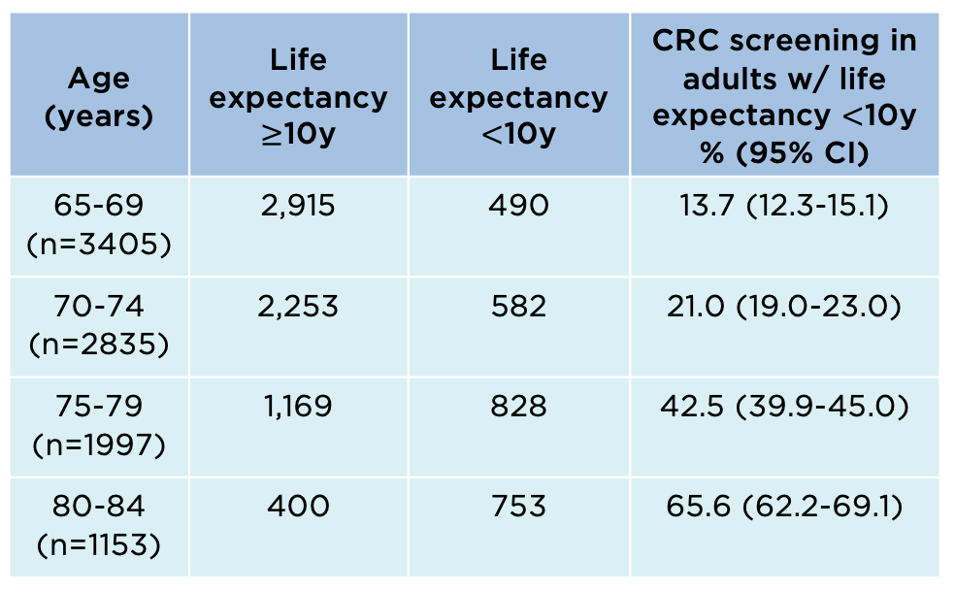
Results
Stratifying by age groups and life-expectancy (>10 years and <10 years), among older adults, the prevalence of past-year CRC screening increased with lower life expectancy.
Table: CRC screening rates in older adults based on life expectancy
Liu et al., American Journal of Gastroenterology 2023; Okafor, Evidence Based GI March 2024: 1-6.

Slide 9
Key Study Findings
28% of older adults who had past year CRC screening had a life expectancy of less than 10 years
Among adults aged 70-79 years, the use of invasive CRC screening modalities increased among those with lower life expectancy
The results of this study show that life expectancy and overall health status are not always considered by healthcare providers when recommending CRC screening in older adults
Liu et al., American Journal of Gastroenterology 2023; Okafor, Evidence Based GI March 2024: 1-6.

Slide 10
Study Limitations
The NHIS survey is based on self-reported participant responses, and responses were not able to be validated by the investigators
Also unable to ascertain the indication for the colonoscopy – whether for screening, surveillance or diagnostic indications
Reported mortality index used to stratify patients may not be as precise at predicting individual mortality risk as it is on the population level
Liu et al., American Journal of Gastroenterology 2023; Okafor, Evidence Based GI March 2024: 1-6.

Slide 11
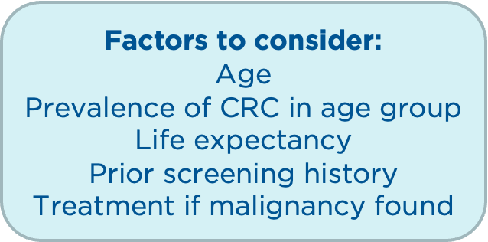
How Should We Apply This to Our Practice?
What are some ways we can incorporate shared-decision making around CRC screening when seeing elderly patients in clinic?
Would writing in the endoscopy report when screening is no longer beneficial help in providing reassurance?
Okafor, Evidence Based GI March 2024: 1-6.

