Slide 1


QR Code
Tirzepatide Improves NASH and Reduces Fibrosis: Findings From the SYNERGY-NASH Trial
Original Article
QR Code
Article covered: Loomba R, Hartman ML, Lawitz EJ, et al. Tirzepatide for metabolic-dysfunction associated
steatohepatitis with liver fibrosis. NEJM 2024;391:299-310.
EBGI Summary

Slide 2
Study Question
Does tirzepatide, a once-weekly GIP and GLP-1 agonist, decrease fibrosis and resolve MASH, formerly known as NASH?
GIP, Glucose-dependent insulinotropic polypeptide
GLP-1, Glucagon-like peptide-1
MASH, metabolic-dysfunction associated steatohepatitis
NASH, non-alcoholic steatohepatitis
Loomba R, et al. NEJM 2024; Rich N. EBGI July 2024

Slide 3
Why is This Important?
GLP-1 receptor agonists (GLP-1 RAs) with GIP have transformed the treatment of obesity and type 2 diabetes.
These agents also help manage conditions like hypertension, metabolic disorders, and obstructive sleep apnea, while reducing overall cardiovascular risk.
Weight loss through lifestyle changes, diet, and bariatric surgery are known to benefit MASH. However, no drugs had shown success in phase 3 trials for decreasing fibrosis and resolving MASH prior to 2024.
Loomba R, et al. NEJM 2024; Rich N. EBGI July 2024
Notes:
1-4
5

Slide 4
Why Is This Important?
Early trials of GLP-1 RAs in patients with obesity and type 2 diabetes suggested positive effects on liver, reducing inflammation and improving chemistry.
Tirzepatide, which combines GLP-1 and GIP receptor agonism, may have additional benefits for MASH beyond weight loss by targeting white adipose tissue.
The SYNERGY-NASH trial provided histologic evidence that tirzepatide can resolve MASH without worsening fibrosis, meeting FDA-endorsed criteria for MASH treatment.
Loomba R, et al. NEJM 2024; Rich N. EBGI July 2024
Notes:
1-4
5

Slide 5
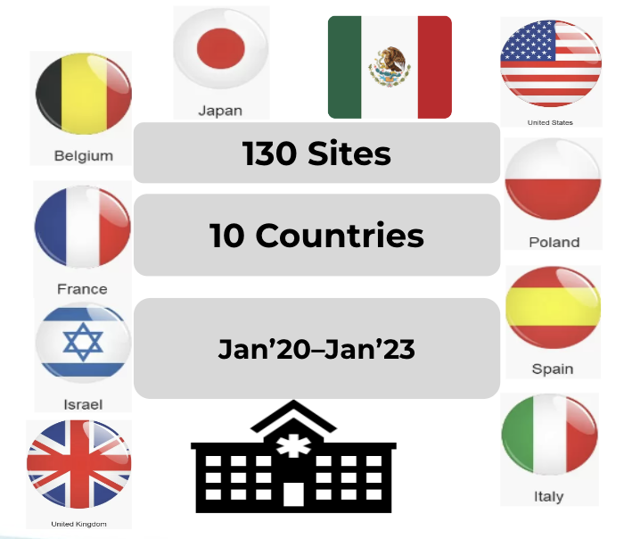

Study Design
Design: Phase II, multicenter, placebo-controlled, dose-finding, double-blind, randomized controlled trial (RCT).
Sites: 10 countries (Belgium, France, Israel, Italy, Japan, Mexico, Poland, Spain, UK, USA).
Duration: January 2020 - January 2023.
5mg
10mg
15mg
Placebo
Loomba R, et al. NEJM 2024; Rich N. EBGI July 2024

Slide 6
Study Patients and Interventions
INCLUSION CRITERIA:
≥18 years - 80 years, with or without type 2 diabetes
BMI 27-50 kg/m²
biopsy-confirmed MASH
NAS ≥4 and fibrosis stage (F2-F3)
EXCLUSION CRITERIA:
Alcohol consumption, >14 drinks/week for women and >21 drinks/week for men.
HbA1c >9.5%
Use of GLP-1 receptor agonists or other weight loss medications
Fibrosis stage F0 (no fibrosis), F1 or F4 (cirrhosis)
Interventions:
Participants were randomized into 4 groups (1:1:1:1):
Tirzepatide 5 mg once weekly
Tirzepatide 10 mg once weekly
Tirzepatide 15 mg once weekly
Placebo once weekly
Administration: Subcutaneous injections for 52 weeks.
Dosing: Started at 2.5 mg once weekly,
increasing by 2.5 mg every 4 weeks until the target dose
(5 mg, 10 mg, or 15 mg).
Loomba R, et al. NEJM 2024; Rich N. EBGI July 2024.

Slide 7
Outcomes & Definitions
Primary Outcome: MASH resolution without worsening fibrosis at week 52.
MASH resolution criteria: No or simple steatosis; minimal lobular inflammation; no ballooning
Secondary Outcomes:
Decrease in at least 1 fibrosis stage w/o worsening MASH.
Decrease of MAFLD activity score by at least 2 points, with at least 1 point reduction in steatosis, lobular inflammation, and hepatocyte ballooning.
Changes in liver fat content via MRI-PDFF.
Changes in body weight.
Loomba R, et al. NEJM 2024; Rich N. EBGI July 2024

Slide 8
Results
Study Population: 190 randomized (mean age 54.4 years, 86% White, 12% Asian, 36% Hispanic). 165 completed the trial, and 157 had evaluable end-of-treatment biopsies at week 52.
Additional demographic data: Mean BMI was 36.1; 52% had type II diabetes mellitus; fibrosis stage at enrollment was F2 in 43% and F3 in 57%. Target tirzepatide dose was achieved among 96%, 96%, and 85% in the 5mg, 10mg, and 15mg subq weekly groups, respectively.
MASH Resolution (Week 52): 44% in 5 mg group, 56% in 10 mg group, 62% in 15 mg group vs 10% in placebo group (P < 0.001 for all three tirzepatide groups vs placebo).
Improvement in Fibrosis Stage (Week 52): 55% in 5 mg group, 51% in 10 mg group, 51% in 15 mg group vs 30% in placebo group. (No adjustment made for multiple comparisons in statistical analysis. P values not reported)
Loomba R, et al. NEJM 2024; Rich N. EBGI July 2024

Slide 9
Results
 | Tirzepatide 5MG | Tirzepatide 10MG | Tirzepatide 15MG | PLACEBO
SECONDARY OUTCOMES
IMPROVEMENT OF AT LEAST 1 FIBROSIS STAGE | 55% | 51% | 51% | 30%
MEAN PERCENTAGE CHANGE IN BODY WEIGHT | -10.7% | -13.3% | -15.6% | -0.8%
ADVERSE EVENTS
NAUSEA | 36% | 34% | 44% | 12%
DIARRHEA | 32% | 36% | 27% | 23%
CONSTIPATION | 23% | 19% | 15% | 6%
Loomba R, et al. NEJM 2024; Rich N. EBGI July 2024.

Slide 10
Key Study Findings
Effectiveness: All three doses of tirzepatide (5 mg, 10 mg, and 15 mg subq weekly) were more effective than placebo in achieving MASH resolution without worsening fibrosis.
Additional Benefits: Tirzepatide improved body weight, liver biochemistries, and noninvasive measures of liver fat, inflammation, and fibrosis.
Safety and Tolerance: Tirzepatide was generally safe and well-tolerated. The most common adverse events were gastrointestinal. Serious adverse events and trial discontinuations were similar across all study arms, including the placebo group.
Loomba R, et al. NEJM 2024, Rich N. EBGI July 2024.

Slide 11
Study Limitations
Duration: The 52-week study period is too short to evaluate the long-term effects of tirzepatide on major adverse liver outcomes (MALO) and fibrosis progression.
Sample Size: The study's small sample size (N=190) may not provide sufficient power to detect subtle differences in fibrosis improvement between tirzepatide and placebo.
Fibrosis Regression Limits: The study did not explore whether there is a maximum extent of fibrosis regression achievable with GLP-1 receptor agonists or weight loss alone.
Exclusion of Certain Populations: Patients with cirrhosis (F4), those without fibrosis (F0), and those with early-stage fibrosis (F1) were excluded, leaving uncertainty about tirzepatide's efficacy in these groups.
Loomba R, et al. NEJM 2024, Rich N. EBGI July 2024.

Slide 12
How Should We Apply This to Our Practice?
Should tirzepatide be considered first-line therapy for MASH with F2/F3 fibrosis in patients with type II diabetes mellitus and/or obesity?
What are the potential benefits of tirzepatide vs resmetirom for treatment of MASH?
Should gastroenterologists become proficient in prescribing tirzepatide and obesity management as part of our practice for patients with MASH?
Loomba R, et al. NEJM 2024, Rich N. EBGI July 2024

Slide 13
REFERENCES
Meier JJ, et al. Nat Rev Endocrinol 2012
Vilsbøll T, et al. BMJ 2012
Malhotra A, et al. N Engl J Med 2024.
Parab P, et al. Cureus 2023
Harrison SA, et al. N Engl J Med 2024
Loomba R, et al. NEJM 2024
Rich N. EBGI July 2024
Loomba R, et al. NEJM 2024, Rich N. EBGI July 2024

