Slide 1
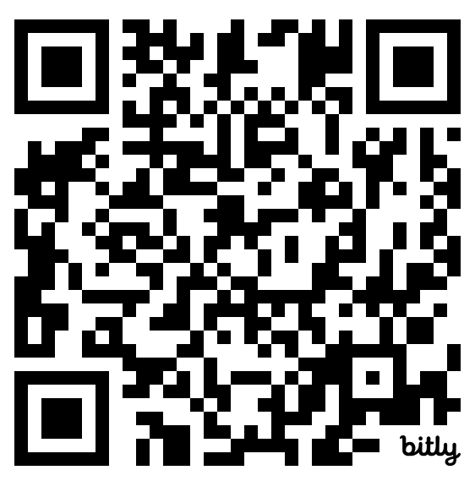
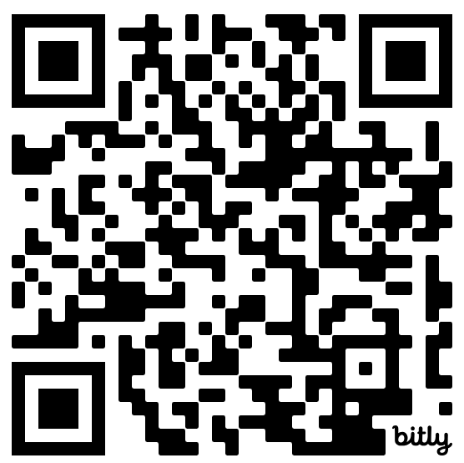
QR Code
Mirikizumab for Induction and Maintenance of Remission in Ulcerative Colitis
Original Article
QR Code
Article covered: D'Haens G, Dubinsky M, Kobayashi T, et al. Mirikizumab as induction and maintenance therapy for ulcerative colitis. N Engl J Med 2023;388(26):2444-2455.
EBGI Summary

Slide 2
Study Question
Is mirikizumab, a monoclonal antibody directed at the p19 subunit of IL-23, effective for induction and maintenance of remission in patients with moderate-severe ulcerative colitis (UC)?
D’Haens, et al. N Engl J Med 2023;388(26):2444-2455. Dalal R. Evidence-Based GI Jan 2024: 1-6.

Slide 3
Why Is This Important?
Although many medications are available for treatment of moderate to severe UC, many patients fail to achieve or lose response over time.
The use of many medications, including anti-TNF agents, is limited by the risk of infection and malignancy.
The interleukin-23 (IL-23) pathway is a target to treat autoimmune disorders while minimizing adverse effects.
Ustekinumab, which targets the p40 subunit of IL-12 and IL-23, was the first IL-23-directed monoclonal antibody approved for treatment of UC and Crohn’s disease.
D’Haens, et al. NEJM 2023;388:2444-2455; Dalal R. Evidence-Based GI January 2024: 1-6

Slide 4
Why Is This Important?
Hypothetically, selective blockade of the p19 subunit of IL-23 will produce better outcomes vs broader blockade of the p40 subunit of IL-12 and IL-23.
Risankizumab, a p19 subunit focused IL-23 monoclonal antibody, is superior to ustekinumab for Crohn’s disease.
Mirikizumab is the first p19 subunit focused IL-23 agent approved by the FDA for UC based on LUCENT-1 and LUCENT-2 RCTs.
D’Haens, et al. NEJM 2023;388:2444-2455; Dalal R. Evidence-Based GI January 2024: 1-6

Slide 5

Study Design
Design: Multicenter, phase 3, 12-week (LUCENT-1) and 40-week (LUCENT-2), double-blind, placebo-controlled, randomized controlled trial
Setting: 384 and 367 centers in 34 countries, conducted from October 2018 through November 2021
Patients: Included 1,281 and 544 patients in LUCENT-1 and LUCENT-2, respectively, with moderate to severe ulcerative colitis
MIRKIZUMAB
LUCENT-1
RESPONSE at WEEK 12
PLACEBO
MIRKIZUMAB
LUCENT-2
CLINCAL OUTCOMES
(WEEK 40)
PLACEBO
INCLUSION CRITERIA
18-80 years of age with moderate to severe ulcerative colitis
D’Haens, et al. NEJM 2023;388:2444-2455; Dalal R. Evidence-Based GI January 2024: 1-6

Slide 6
Interventions
LUCENT-1: Mirikizumab 300 mg intravenously vs placebo IV every 4 weeks for 12 weeks
LUCENT-2: Mirikizumab 200 mg subcutaneous vs placebo every 4 weeks for 40 weeks
D’Haens, et al. NEJM 2023; 388:2444-2455; Dalal R. Evidence-Based GI January 2024: 1-6

Slide 7
Outcomes & Definitions
Primary Outcome
Clinical remission at week 12 in LUCENT-1
Clinical remission at week 40 (week 52 overall) for LUCENT-2
Clinical remission defined as stool frequency score of 0-1, rectal bleeding score of 0-1, and endoscopic score of 0-1, based on modified Mayo Score.
Secondary Outcomes
Clinical response
Endoscopic response
Improvement in bowel movement urgency using Urgency Numeric Rating Scale
D’Haens, et al. NEJM 2023;388:2444-2455; Dalal R. Evidence-Based GI January 2024: 1-6

Slide 8
Results
Total of 1,281 and 544 patients with moderate to severe ulcerative colitis were randomized in LUCENT-1 and LUCENT-2, respectively.
Mean age: 41-43 years old; 56-61% male
Disease characteristics: disease duration 6.9-7.2 years; left-sided colitis 63-64%; previous treatment failure with biologics 40-42% or inadequate response to biologics 23-24%.
Mirikizumab-treated patients more likely to achieve clinical remission after 12 weeks: 24.2% vs 13.3%, respectively, p < 0.001.
Mirikizumab-treated patients more likely to maintain clinical remission over 40 weeks: 49.9% vs 25.1%, respectively, p < 0.001.
D’Haens, et al. NEJM 2023;388:2444-2455; Dalal R. Evidence-Based GI January 2024: 1-6

Slide 9
Results
D’Haens, et al. NEJM 2023;388:2444-2455; Dalal R. Evidence-Based GI January 2024: 1-6

Slide 10
Results
D’Haens, et al. NEJM 2023;388:2444-2455; Dalal R. Evidence-Based GI January 2024: 1-6

Slide 11
Results
Adverse events similar in the mirikizumab and placebo groups.
Six cases of herpes zoster in the mirikizumab group (compared to 1 in control)
In mirikizumab group, CRC reported in two patients during 12-week induction period and unlikely related to drug. Non-melanoma skin cancer and gastric cancer reported in one patient each during 40-week maintenance period. Zero cancers reported in placebo group.
D’Haens, et al. NEJM 2023;388:2444-2455; Dalal R. Evidence-Based GI January 2024: 1-6

Slide 12
Key Study Findings
Patients taking mirikizumab were more likely to achieve and maintain UC clinical remission compared to placebo-treated patients.
Patients taking mirikizumab were more likely to achieve clinical response and endoscopic response.
First study to report and demonstrate improvement in bowel movement urgency using the Urgency Numerical Rating Scale.
Similar rates of adverse events in both groups
D’Haens, et al. NEJM 2023;388:2444-2455; Dalal R. Evidence-Based GI January 2024: 1-6

Slide 13
Study Limitations
Numerically more cancer and herpes zoster in mirikizumab arm.
Long term data needed to further assess safety profile.
Comparative studies with IL-23 agents and other biologics needed to determine optimal placement of mirikizumab among IBD medications.
D’Haens, et al. NEJM 2023;388:2444-2455; Dalal R. Evidence-Based GI January 2024: 1-6

Slide 14
How Should We Apply This to Our Practice?
Where should mirikizumab be placed in moderate-severe UC management compared to other therapies?
Is ustekinumab preferable since it’s dosed every 8 weeks? Is mirikizumab preferable because it’s directed at the p19 subunit of IL-23?
Should we consider mirikizumab in patients with secondary loss of response to ustekinumab or use agents with different MOAs?
Should mirikizumab be considered as a first option for UC patients with significant fecal urgency?
D’Haens, et al. NEJM 2023;388:2444-2455; Dalal R. Evidence-Based GI January 2024: 1-6

