Slide 1


Vibrating Capsules for Chronic Constipation
EBGI Summary
Article Covered: Rao SSC, Quigley EMM, Chey WD, Sharma A, Lembo AJ. Randomized Placebo-Controlled Phase 3 Trial of Vibrating Capsule for Chronic Constipation. Gastroenterology. 2023 Jun;164(7):1202-1210.e6.
Original Article

Slide 2
Study Question
Is a vibrating capsule superior to placebo in chronic idiopathic constipation (CIC) for symptoms based on US Food and Drug Administration (FDA)-defined responder endpoints?

Slide 3
Why is This Important?
CIC therapeutic armamentarium has expanded, but many CIC patients fail to achieve adequate relief and seek out new treatments
Vibrating capsules to stimulate colonic motility while minimizing diarrhea is an intriguing idea
This trial reports the Phase 3 data which led to FDA approval for this first-in-class vibrating capsule system
Oh et al. AJG 2020; 115: 895-905.

Slide 4






Study Design
Design: Multicenter, 8-week, double-blind, placebo-controlled, randomized trial
Setting: 95 United States centers, conducted from April 2019 through July 2021
Patients: Included 312 outpatients meeting Rome III criteria for chronic idiopathic constipation (CIC)
NEW
Rao et al. Gastroenterol 2023;164(7):1202-1210; Schoenfeld P. Evidence-Based GI April 2023: 1-4.

Slide 5
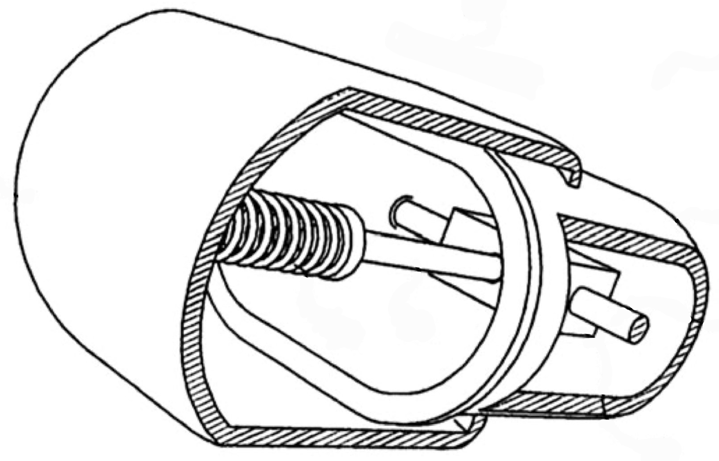
Interventions
Latex-free plastic shell
Shell with two attached segments, but moves independently
Vibrating capsule swallowed 5 evenings/week vs sham dissolvable placebo capsule
Each capsule was programmed to begin vibrating at noon the following day, with 2 separate vibration cycles over 2 days
Each vibration cycle consisted of 3 sec of oscillation followed by 16 sec of rest (3 stimulations per min) for 2 hours
24 mm (length)
11 mm (diameter)
Motor for inducing vibrations
Rao et al. Gastroenterol 2023;164:1202-1210; Ron et al. Neurogastroenterol Motil 2015;27:99-104; Schoenfeld P. EBGI April 2023: 1-4.

Slide 6
Outcomes & Definitions
Co-primary endpoints were proportion of patients with:
Increase of > 1 weekly complete spontaneous bowel movements (CSBM) from baseline for >6 of 8 weeks
Increase of >2 weekly CSBM from baseline for >6 of 8 weeks
Secondary endpoints included
Changes in stool consistency
Straining and bloating
Spontaneous bowel movement (SBM) defined as BM without using rescue medication in preceding 48 hours and without use of digital maneuvers
CSBM was a SBM with a sense of complete evacuation
Rao et al. Gastroenterol 2023;164(7):1202-1210; Schoenfeld P. Evidence-Based GI April 2023: 1-4.

Slide 7
Results
312 CIC patients were randomized
Mean age: 46‒47 years old; 85%‒88% female; 40%‒47% White
Baseline symptoms: 0.4 CSBMs/week, 1.6‒1.7 SBMs/week, mean Bristol Stool Scale 2.1
Adverse event data reported 11% of vibrating capsule-treated patients reported vibrating sensation in abdomen, but did not lead to study discontinuation
Rao et al. Gastroenterol 2023;164(7):1202-1210; Schoenfeld P. Evidence-Based GI April 2023: 1-4.

Slide 8
Results
P-value <0.0001
P-value <0.0008
Incremental CSBM (Complete Spontaneous Bowel Movement)
Rao et al. Gastroenterol 2023;164(7):1202-1210; Schoenfeld P. Evidence-Based GI April 2023: 1-4.

Slide 9
Key Study Findings
Patients using vibrating capsule were more likely than placebo-treated patients to achieve both co-primary endpoints
Increase of > 1 weekly CSBM for > 6 of 8 weeks (39.3% vs 22.1%, respectively, P < 0.0001)
Increase of > 2 weekly CSBM for > 6 of 8 weeks (22.7% vs 11.4%, respectively, P < 0.0008)
Rao et al. Gastroenterol 2023;164(7):1202-1210; Schoenfeld P. Evidence-Based GI April 2023: 1-4.

Slide 10
Study Limitations
The study duration is relatively short (8 weeks) for a chronic condition
Appropriate blinding to treatment group could have been impacted in 11% of vibrating capsule-treated patients who noted a vibrating sensation in their abdomen
The current trial only examined 1 activation mode or vibration cycle
Rao et al. Gastroenterol 2023;164(7):1202-1210; Schoenfeld P. Evidence-Based GI April 2023: 1-4.

Slide 11
How Should We Apply This to Our Practice?
How could the vibrating capsule be positioned in the therapeutic armamentarium for chronic constipation?
Are there any patients who should avoid using vibrating capsule?
How would patients in our practice setting afford this therapy?
Manufacturer advertises a self-pay option for $89/month
Schoenfeld P. Evidence-Based GI April 2023: 1-4.

