Slide 1
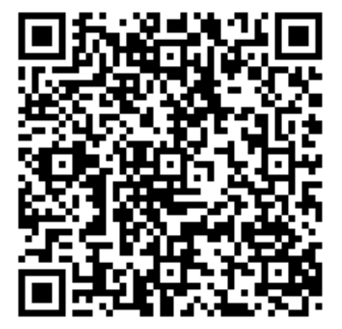
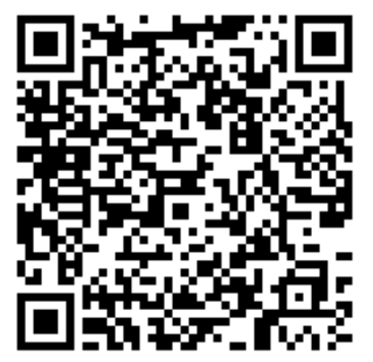
Low-dose Tricyclic Antidepressants (TCA) for IBS
Original Article
Article covered: Ford AC, Wright-Hughes A, Alderson S, et al. Amitriptyline at Low-Dose and Titrated for Irritable Bowel Syndrome as Second-Line Treatment in Primary Care (ATLANTIS): A Randomised, Double-Blind, Placebo-Controlled, Phase 3 Trial. Lancet 2023; 402: 1773-85
EBGI Summary

Slide 2
Study Question
Is amitriptyline 10 mg-30 mg taken orally at bedtime superior to placebo for improvement in irritable bowel syndrome (IBS) symptoms in the primary care setting at 6 months?
Ford et al. Lancet 2023; 402: 1773-85; Schoenfeld P. Evidence-Based GI December 2023: 1-4.

Slide 3
Why is This Important?
IBS is very common and debilitating, yet optimal treatment is unclear due to limited randomized controlled trial (RCT) data about multiple commonly-used treatments
Studies about tricyclic antidepressant (TCA) use for IBS have various design limitations; therefore, the ACG & AGA guidelines only provide conditional recommendations suggesting that TCAs use in IBS
The ATLANTIS study is major effort to quantify the benefit of amitriptyline in a 6-month RCT
Ford et al. Lancet 2023; 402: 1773-85; Schoenfeld P. Evidence-Based GI December 2023: 1-4.

Slide 4






Study Design
Design: Multicenter, double-blind, placebo RCT with 1:1 randomization
Setting: 55 general practices/primary care centers in England
Patients: >18 years old with IBS based on ROME IV criteria, IBS-Symptom Severity Score [IBS-SSS] >75 (0-500 scale), normal hemoglobin, normal c-reactive protein, negative anti-tissue transluaminase, no evidence of suicidal ideation, and failure to respond to first-line treatments (e.g., diet modification, soluble fiber, antispasmodics, or laxatives/antidiarrheals)
RANDOMIZED 1:1
PLACEBO
AMITRIPTYLINE 10MG AT NIGHT
Ford et al. Lancet 2023; 402: 1773-85; Schoenfeld P. Evidence-Based GI December 2023: 1-4.

Slide 5
Interventions
Amitriptyline 10 mg taken orally at night vs placebo
Patients educated to titrate dose upward to max of 3 tablets (30 mg amitriptyline or 3 placebo tablets) over 3 weeks based on improvement in IBS symptoms
Throughout the study, patients could further titrate dose up or down based on severity of IBS symptoms or side effects
Ford et al. Lancet 2023; 402: 1773-85; Schoenfeld P. Evidence-Based GI December 2023: 1-4.

Slide 6
Outcomes & Definitions
Primary endpoint: Change in IBS-SSS from baseline at 6 months
IBS-SSS range: 0-500. Mild IBS: 75-175; moderate IBS: 176-300; severe IBS: >300.
A change of 35 points in IBS-SSS = minimal clinically important difference.
Secondary endpoints: Subjective global assessment of relief of IBS symptoms at 6 months
Defined as having somewhat relieved or better based on ordinal scale of global IBS symptoms being: worse; unchanged; somewhat relieved; considerably relieved; or completely relieved compared to baseline
Ford et al. Lancet 2023; 402: 1773-85; Schoenfeld P. Evidence-Based GI December 2023: 1-4.

Slide 7
Demographic Data
463 IBS patients were enrolled
Mean age: 48-49 years old; 67%-69% female
Mean IBS-SSS at baseline = 273; 80% IBS-D or IBS-M
84% normal scores on HADS-Depression instrument
85% moderate-severe IBS based on baseline IBS-SSS
Median IBS duration of 10 years
Ford et al. Lancet 2023; 402: 1773-85; Schoenfeld P. Evidence-Based GI December 2023: 1-4.

Slide 8
Demographic Data
At 6 months, mean IBS-SSS
Amitriptyline group: ⇩ from 273 to 170
Placebo group: ⇩ from 272 to 200
Mean difference in IBS-SSS score: -27.0; 95% CI: -46.9 to -4.6; P = 0.008
Ford et al. Lancet 2023; 402: 1773-85; Schoenfeld P. Evidence-Based GI December 2023: 1-4.

Slide 9
Results
Secondary outcome: Amitriptyline group more likely to achieve at least somewhat relief of global IBS symptoms (OR 1.78, 95% CI 1.19-2.66) or for considerable/complete relief of global IBS symptoms (OR 1.88, 95% CI 1.20-2.95)
Side Effects: Discontinuation of study medication due to adverse events was 13% amitriptyline vs 9% placebo
Ford et al. Lancet 2023; 402: 1773-85; Schoenfeld P. Evidence-Based GI December 2023: 1-4.

Slide 10
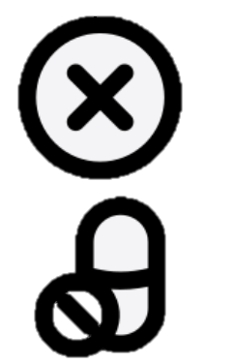
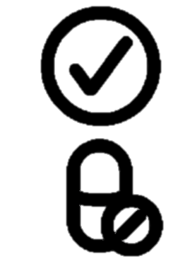

Key Study Findings
Amitriptyline was superior to placebo for decreasing IBS-SSS (mean difference in IBS-SSS score: - 27.0; 95% CI: -46.9 to -4.6; p = 0.008) and for achieving somewhat, considerable, or complete relief of global IBS symptoms at 6 months
Ford et al. Lancet 2023; 402: 1773-85; Schoenfeld P. Evidence-Based GI December 2023: 1-4.

Slide 11
Study Limitations
Benefit observed with amitriptyline was modest. Did not meet the minimal clinically important difference in IBS-SSS reduction of 35 points compared to placebo
Rigorous responder endpoints required by US and European agencies for drug trials in IBS-D and IBS-C were not used
Inclusion of IBS-C patients (17%) may have decreased the observed benefit of amitriptyline in overall IBS population
Ford et al. Lancet 2023; 402: 1773-85; Schoenfeld P. Evidence-Based GI December 2023: 1-4.

Slide 12
How Should We Apply This to Our Practice?
How should TCAs be positioned in the therapeutic armamentarium for IBS?
Which IBS patients may not be good candidates for TCA therapy?
How do you counsel patients to titrate low dose TCAs?
How do you counsel about “success” of TCAs for IBS symptoms?
Schoenfeld P. Evidence-Based GI December 2023: 1-4.

