Slide 1


QR Code
Endoscopic Submucosal Resection vs Endoscopic Mucosal for Large Nonpedunculated Colon Polyps
Original Article
QR Code
Article covered: Jacques J, Schaefer M, Wallenhorst T, et al. Endoscopic en bloc versus piecemeal resection of large nonpedunculated colonic adenomas: A randomized comparative trial. Ann Intern Med 2024; 177: 29-38
EBGI Summary

Slide 2
Study Question
Does endoscopic submucosal dissection (ESD) decrease incomplete polyp resection/polyp recurrence of large (≥25 mm) colon polyps with similar rates of adverse events compared to conventional piecemeal endoscopic mucosal resection (EMR)?
Jacques et al. Ann Intern Med. 2024;177(1):29-38. Lee J. Evidence-Based GI March 2024: 1-6.

Slide 3
Why is This Important?
Endoscopic resection of adenomas prevents colorectal cancer, but the optimal technique for larger lesions is controversial
Piecemeal EMR has a low adverse event (AE) rate but a variable recurrence rate necessitating early follow-up
ESD can reduce recurrence but may increase AEs
Jacques et al. Ann Intern Med. 2024;177(1):29-38. Lee J. Evidence-Based GI March 2024: 1-6.

Slide 4



Study Design
Design: Multi-center, prospective, randomized, comparative trial (RESECT-COLON trial)
Setting: 6 French referral centers from Nov 2019 to Feb 2021 with 13 experienced endoscopists
Patients: Adults >18 years old referred for resection of large (≥25 mm) polyps
Excluded rectal lesions & endoscopic evidence of deep submucosal invasion
Jacques et al. Ann Intern Med. 2024;177(1):29-38. Lee J. Evidence-Based GI March 2024: 1-6.

Slide 5
Interventions
Randomized (1:1 ratio) to EMR or ESD
General anesthesia with intubation & hospitalized for 1 night per standard of care in France
Submucosal injection performed prior to all polypectomies
The choice of endoscope, injection fluid, & specific ESD/EMR devices were at discretion of endoscopist
ESD included dissection around & underneath the lesion to achieve en bloc resection
EMR was performed with piecemeal polypectomies with snare-tip thermal ablation at polypectomy margins.
Clip closure of resection site performed at discretion of endoscopist
Jacques et al. Ann Intern Med. 2024;177(1):29-38. Lee J. Evidence-Based GI March 2024: 1-6.

Slide 6
Outcomes & Definitions
Primary outcome:
Neoplastic recurrence at polypectomy site at 6-month follow-up colonoscopy (all polypectomy scars were biopsied)
Secondary endpoints
Frequency of adverse events
Procedure time
Jacques et al. Ann Intern Med. 2024;177(1):29-38. Lee J. Evidence-Based GI March 2024: 1-6.

Slide 7






Results
360 patients randomized; mean age 69-71 years old with mostly right colon lesions (77%)
Failure to complete procedure rates: low for ESD (3.4%) vs EMR (1.6%)
En bloc resection rate: significantly higher w/ ESD (96.6%) vs EMR (10.4%)
Recurrence rate: lower w/ ESD (1/161, 0.6%) vs EMR (8/157, 5.1%)
Endoscopic submucosal dissection (ESD) required significantly more time vs endoscopic mucosal resection (47 min vs 14.5 min)
Adverse events: significantly higher w/ ESD (35.6%) vs EMR (24.5%)
Jacques et al. Ann Intern Med. 2024;177(1):29-38. Lee J. Evidence-Based GI March 2024: 1-6.

Slide 8
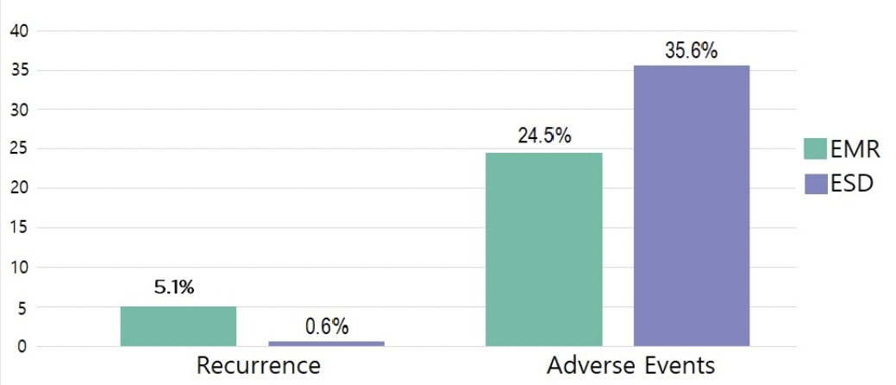
Results
Jacques et al. Ann Intern Med. 2024;177(1):29-38. Lee J. Evidence-Based GI March 2024: 1-6.

Slide 9
Key Study Findings
Recurrence rate significantly lower in ESD vs EMR (0.6% vs 5.1%), but endoscopic resection of residual neoplasia during 6-month follow-up colonoscopy was achieved in all EMR patients
ESD produced significantly more adverse events than EMR (35.6% vs 24.5%) – including post-polypectomy syndrome (11.8% vs 5.5%, respectively; risk ratio = 2.2; 95% CI: 1.1-4.5) as well as numeric increases in periprocedural perforation (5.6% vs 2.2%) & clinically significant post-procedural bleeding (7.9% vs 5.5%)
Jacques et al. Ann Intern Med. 2024;177(1):29-38. Lee J. Evidence-Based GI March 2024: 1-6.

Slide 10
Study Limitations
Study was conducted by experts in ESD and EMR
Study included sessile serrated lesions, which may not be ideal lesion for ESD
Low risk of harboring any low-risk submucosal invasive cancer
Ease of resection with more safer and effective methods
Patients with rectal lesions were excluded
Lee J. Evidence-Based GI March 2024: 1-6.

Slide 11
How Should We Apply This to Our Practice?
What patient factors and polyp features would most influence your decision for resection modality?
Which patients benefit most from en bloc resection?
How would you counsel patients about risks of each technique?
Lee J. Evidence-Based GI March 2024: 1-6.

